Slide 1
American History Part 2: Unit 1 Lecture 2
Industry and Railroad Boom

Slide 2
The Rapid Growth of Industry
Rapid Industrial Growth in US at the end of the 19th century. Factors:
Plentiful natural resources
Government / public support for business
Large and growing urban population

Slide 3
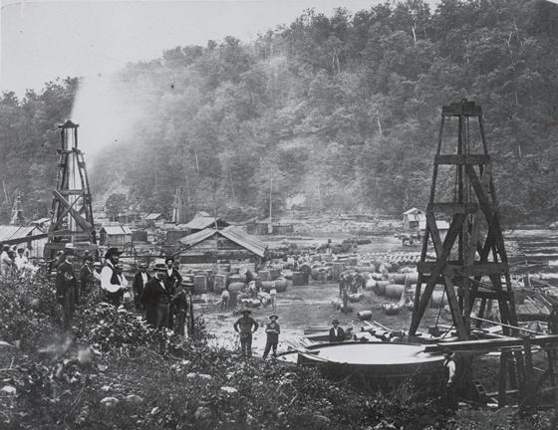
Natural Resources
Edwin Drake’s Oil drilling process
Bessemer Process – produces steel by removing Carbon from Iron
Coal Mining
Railroads are large consumers
1

Slide 4
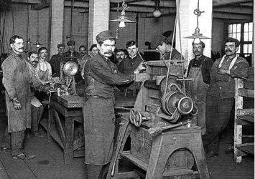
Public Support / Immigrants
Laissez –Faire policies toward industry
High tariff
Public financing of Railroads
Government subsidies for business
Large numbers of immigrants arriving to fill jobs
2

Slide 5
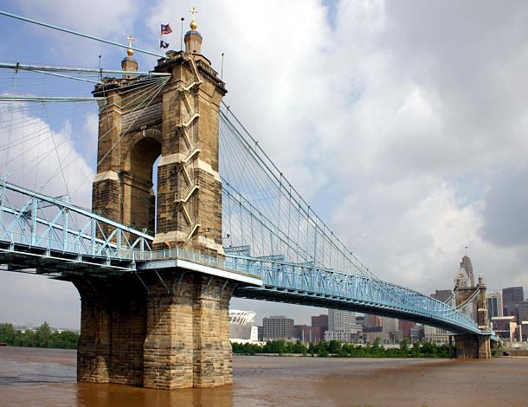
Innovation
Industrial growth is paralleled by an amazing outburst of American invention
Steel allows for construction of first suspension bridges and skyscrapers
Cities are growing
John Roebling Bridge in Cincinnati; an early example of steel’s uses.

Slide 6
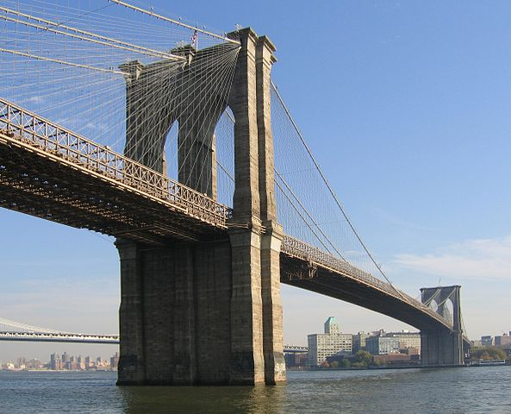
Steel and its Uses
John Roebling’s 5,989 foot Brooklyn Bridge – completed in 1883.

Slide 7
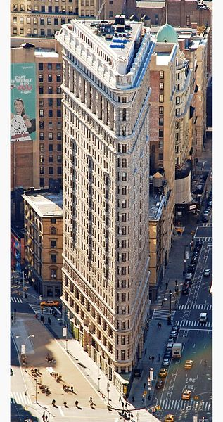
Steel and its Uses
The Flatiron Building. Completed in 1902, it is one of New York’s first skyscrapers.

Slide 8
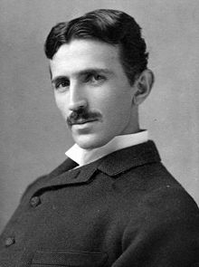
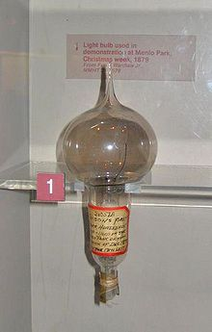
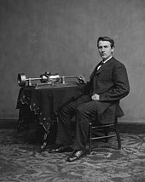
Late 1800’s Inventions:
Telephone by Alexander Graham Bell
Light Bulb, phonograph, motion pictures by Thomas Edison
Electrical power – Perfected by Nikola Tesla
Radio – Tesla
Photography – growing more available
Typewriter – Christopher Sholes

Slide 9
The Railroad Age*
Known as the “Iron Horse”, by 1890, nearly 200,000 miles of track across country
Leads to standardized time zones
Largest consumer of industrial items like steel and coal
Allows country to grow
Cities spring up along tracks
*Click for a primary source description of the railroad by Mark Twain.

Slide 10
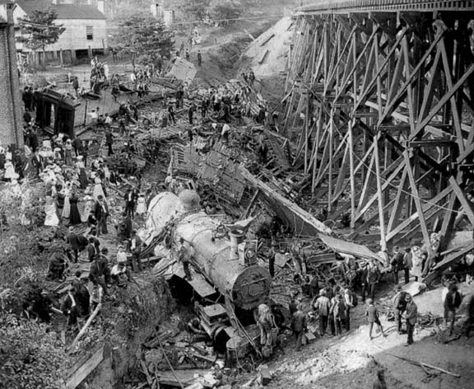
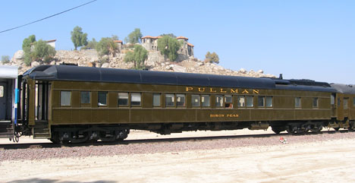
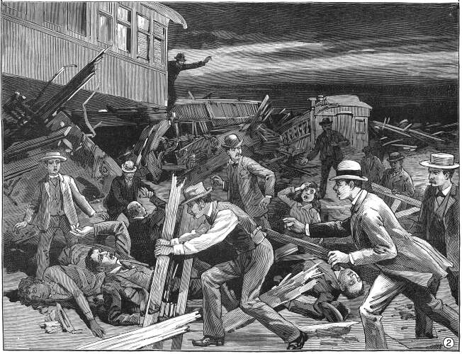
The famous Pullman Car
Due to a lack of regulation, rail accidents were all too common.

Slide 11
Railroad Controversies
Pullman, Illinois – “Company town” where railcars were manufactured; strict control over worker lives
Railroad scandals –
Abuse of land grant programs
Fraudulent stocks sales
Credit Mobilier scandal
Accidents and deaths (no oversight)
Overcharging of farmers

Slide 12
Grange vs. Railroads
Farmers in Grange fought railroad abuses legally
Granger Laws passed by many Western states
Munn v. Illinois :States won right to regulate railroad charges
Overturned b y Supreme Court, but Congress passes Interstate Commerce Act in 1887
Designed to oversee railroads – “keep them honest”

Slide 13
Railroads Consolidate
Interstate Commerce Commission had little power, but was a beginning of government oversight
Following Panic of 1893, numerous railroads bought up by economically powerful railroad trusts
By 1900, 7 companies control 2/3 of nation’s track

Slide 14
1. from http://sjvgeology.org
2. from http://www.nps.gov
3. from http://www.oerm.org

